Slide 1

Predicting Fantasy Football Lineups
Jared Booth
Notes:
Hello everyone! I am Jared Booth and I have been playing fantasy football for 6 years now, I am even the commissioner of one of my leagues. I like the comptitiveness and the strategy, plus it gives me an excuse to watch football all day. I wanted to apply my knowledge of data science to see if I could create a model that would be able to play fantasy football.

Slide 2
Notes:
7 billion dollar industry.

Slide 3
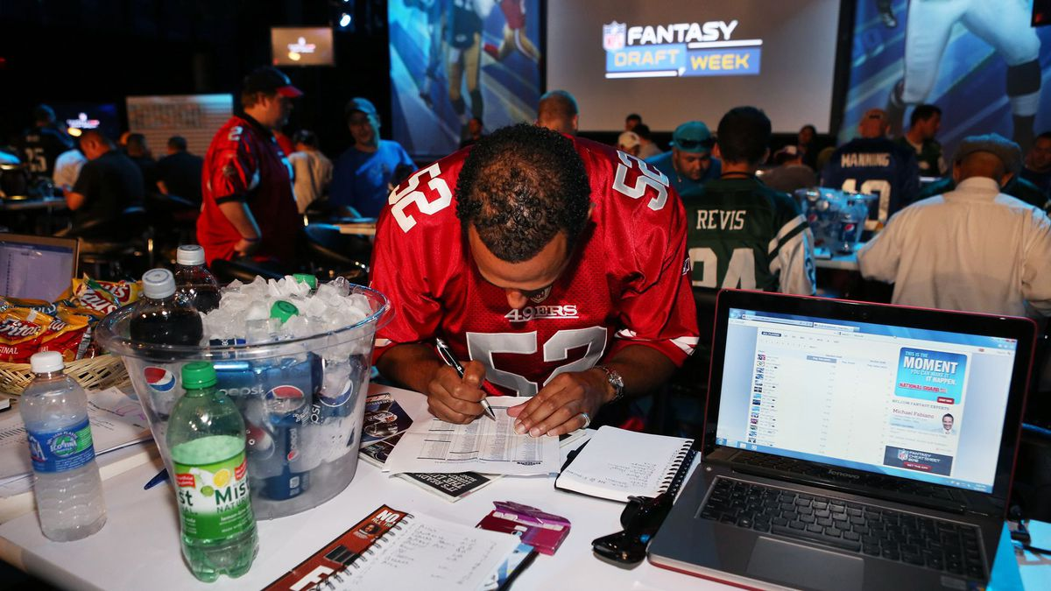
What is Weekly Fantasy Football?

Slide 4
Example Line-up

Slide 5
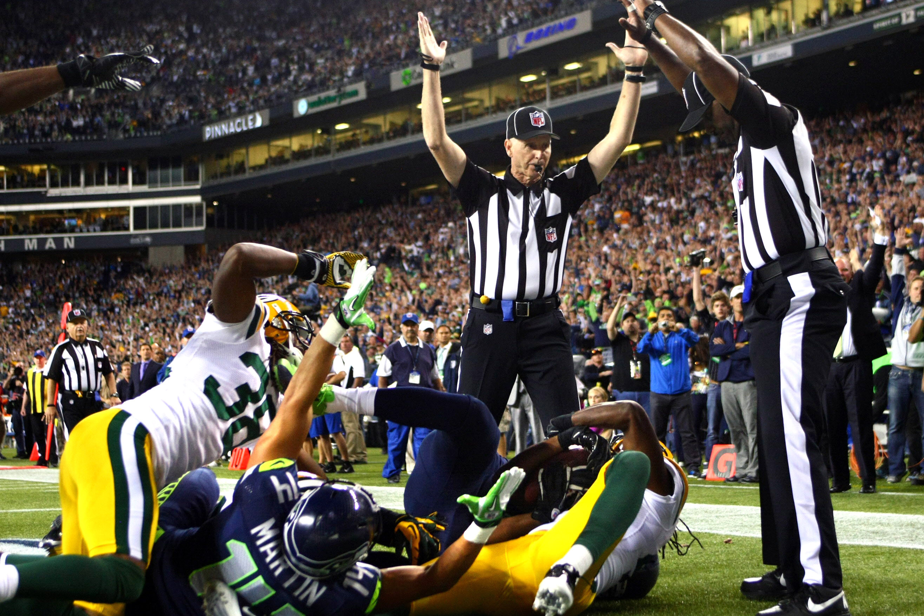
Goal
Create a model that will predict which players will earn the most points each week

Slide 6
Data
Scraped the data from multiple sources using BeautifulSoup
Pro-football-reference.com
fftoday.com
Included features that are known prior to the beginning of a game

Slide 7
Model
Created a deep learning model in Keras called an LSTM which can be used for time series data

Slide 8
Method
I trained the models on three years of data leading up to the 2017 season
I then tested each week of the 2017 season and added each past week back into the training set
Test
Train

Slide 9
Results

Slide 10
Results

Slide 11
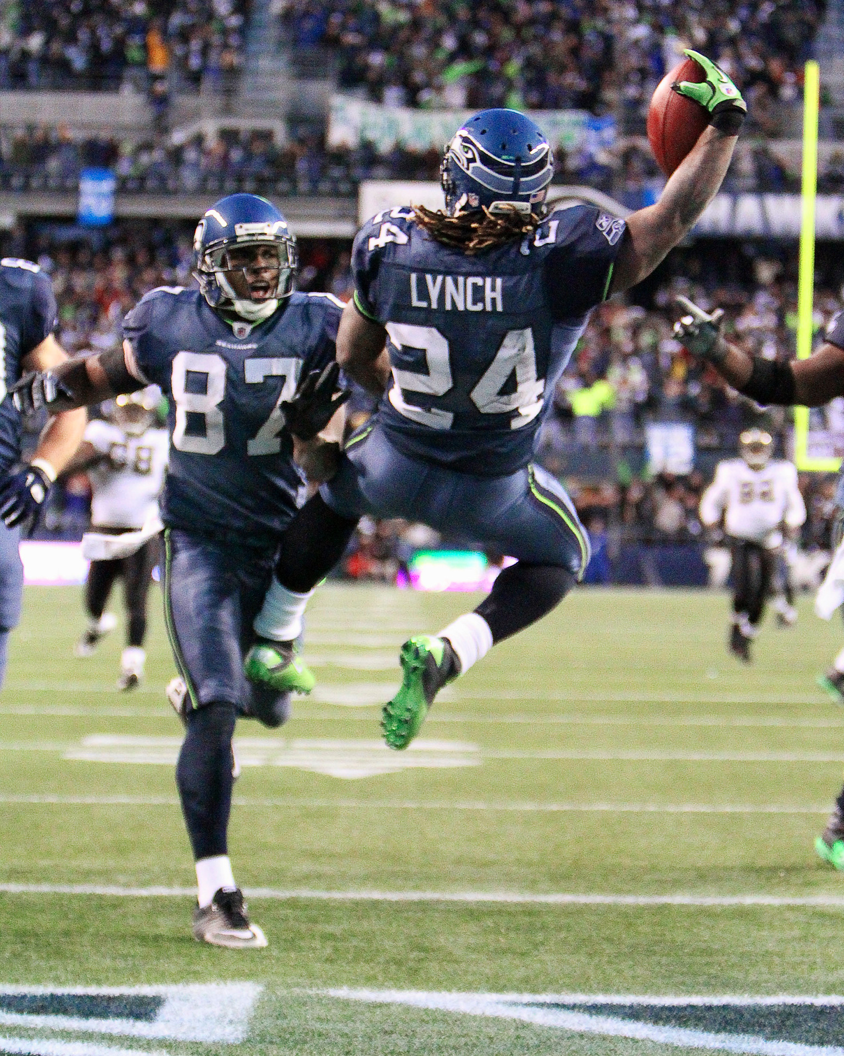
Conclusion
This model has the potential to be competitive with human players
Is better at predicting some positions than others

Slide 12
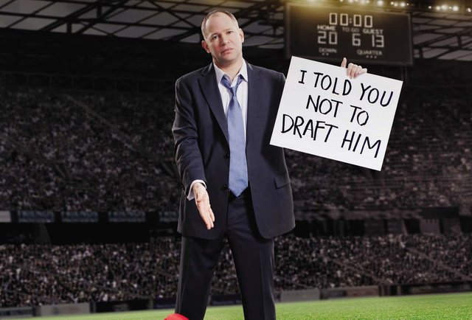
Next steps
Get point projection data

Slide 13
THANK YOU
Email: jzbooth@comcast.net
Blog: jzbooth.github.io/Booth_Metis/
Linkedin: https://linkedin.com/in/JaredZBooth

